Slide 1
Wildfire Smoke & Health for Healthcare Providers
California Area Indian Health Service

Slide 2
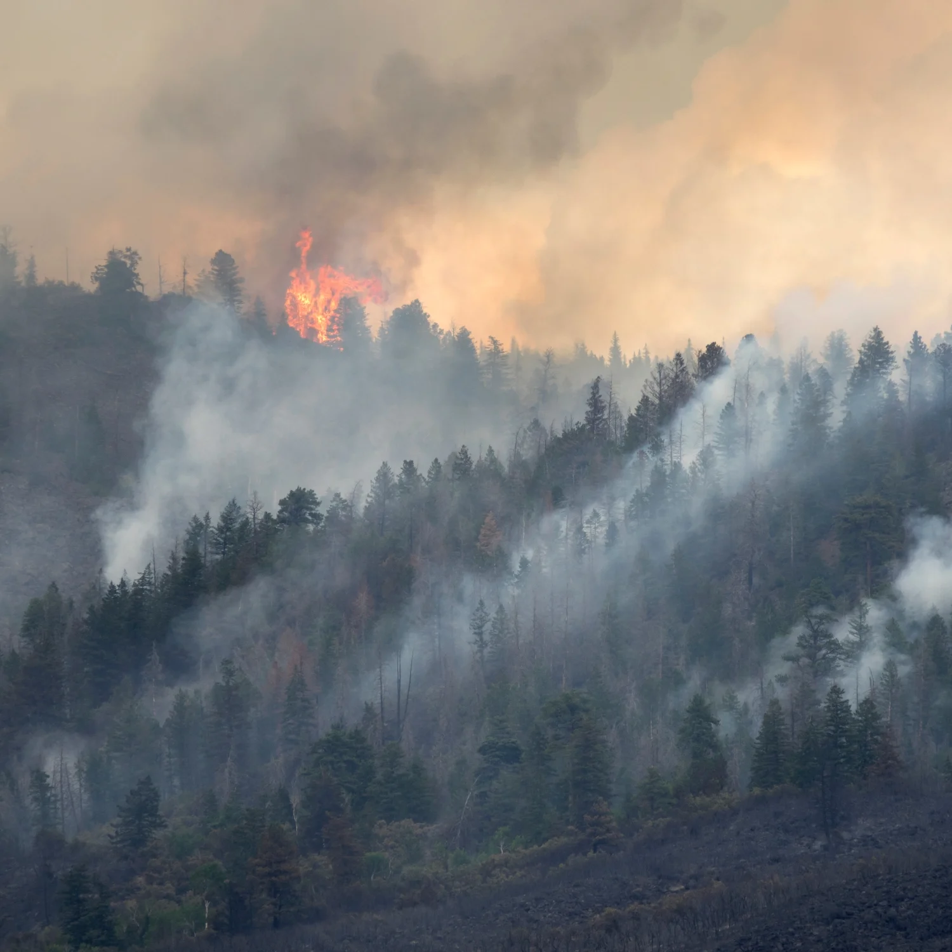
Overview
Components of Wildfire Smoke
Populations Highly Susceptible to Wildfire Smoke Exposure
PM2.5 Exposure Pathology
Synergistic Effects Between Wildfire Smoke Exposure and Extreme Heat
Recommended Interventions
Provider Resources
Notes:
Photo Reference: https://www.google.com/url?sa=i&url=https%3A%2F%2Fwww.outsideonline.com%2Fhealth%2Fwellness%2Fwildfire-smoke-health-effects%2F&psig=AOvVaw0ymkQPhhl7oTjKyO19HnWq&ust=1712178775473000&source=images&cd=vfe&opi=89978449&ved=0CBQQjhxqFwoTCIjVhZe5pIUDFQAAAAAdAAAAABAJ

Slide 3
Wildfire Smoke Components
Notes:
Ask audience this question.
Follow up with “What is the component of wildfire smoke we are most concerned about?”

Slide 4
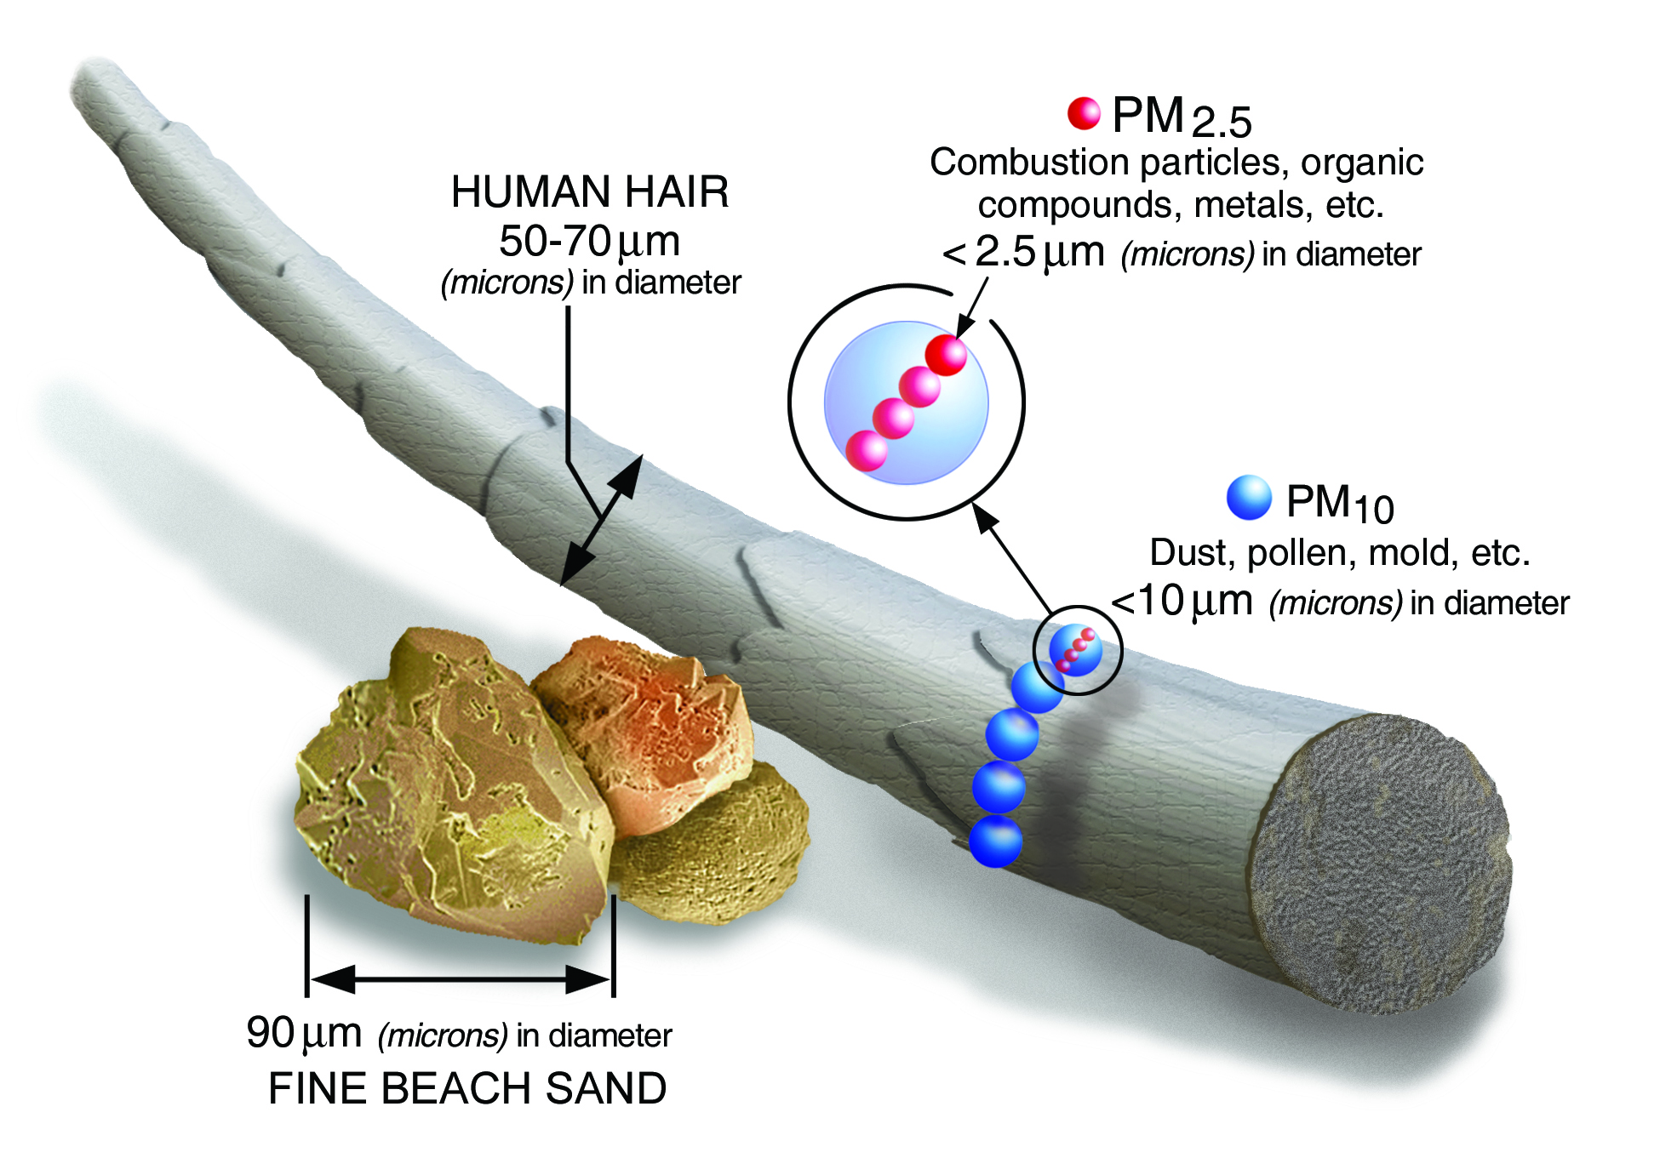
Wildfire Smoke Components
Mix of small particles, gases, and water vapor.
Harmful components include:
  Carbon monoxide;
  Ozone;
  Volatile organic compounds;
  Particulate Matter.
    PM 2.5
      Smallest particles, biggest concern with wildfire smoke.
    PM 10
Notes:
CO colorless, odorless, gas, combustion byproduct, exposure: Headache, dizziness, fatigue, shortness of breath, blurry/double vision, chest pain, nausea and vomiting
Ozone: produced in smoke plumes, exacerbate asthma, COPD, cause coughing throat irritation, congestion
VOCs: similar symptoms, except more systemic effects in liver kidneys, CNS

Slide 5
Highly Susceptible Populations
“Sensitive Groups”

Slide 6
Sensitive Groups
Children:
  Lungs are still growing.
  Faster breathing rate causing higher inhaled concentration of particulates relative to small body size vs. adults with the same environmental exposure.
Older Adults:
  Have higher prevalence of lung and heart disease. (Also, a higher chance of undiagnosed disease.)
Individuals with Chronic Respiratory or Cardiovascular Disease:
  Inhaling particulate matter can aggravate these diseases and worsen symptoms.
    Asthma;
    Chronic Obstructive Pulmonary Disease (COPD);
    Heart Disease.
Pregnant Women:
  Have higher breathing rates and more blood volume which results in more particles in the body.
People at lower socioeconomic status:
  At greater risk due to high utility cost of running air conditioning and air purifiers during a smoke event, the high costs of HEPA air purifiers and generally less access to medical care.
Notes:
https://www.ncbi.nlm.nih.gov/pmc/articles/PMC9657128/
Also, people of lower socioeconomic status are at increased risk for negative health outcomes from smoke exposure due to affordability of running HVAC constantly, high cost of commercial portable HEPA air purifiers, less access to medical care or less likely to seek care due to cost.

Slide 7
PM2.5 Exposure Pathology

Slide 8
PM2.5 Exposure Pathology
Sensitive groups have a higher risk for more severe symptoms when compared to healthy adults experiencing the same exposure.
Short term exposure:
  Healthy Adults & Children Health Effects: eye/nose/throat irritation, coughing, phlegm, chest tightness, difficulty breathing or shortness of breath with exertion.
  Sensitive Group Health Effects: aggravates lung disease, develop acute bronchitis and can trigger asthma attacks, heart attack, heart arrhythmias and stroke.
Long term exposure:
  Reduced lung function, chronic bronchitis and premature death.
  Air pollution shortens lifespan by 1.5 years on average throughout the USA*.
*Source: Cardiovascular Research, Vol. 116, Issue 7, June 2020 pp.1334
https://academic.oup.com/cardiovascres/article/116/11/1910/5770885
Notes:
Source: Cal EPA Air Resources Board: Fact Sheet Smoke Management and Public Health (2/2003); EPA 452/R-19-901 Wildfire Smoke a Guide for Public Health Officials Rev. 2019
Sensitive groups have higher risks for more severe symptoms from similar exposure when compared to healthy adults. *Read listed severe impacts*

Slide 9
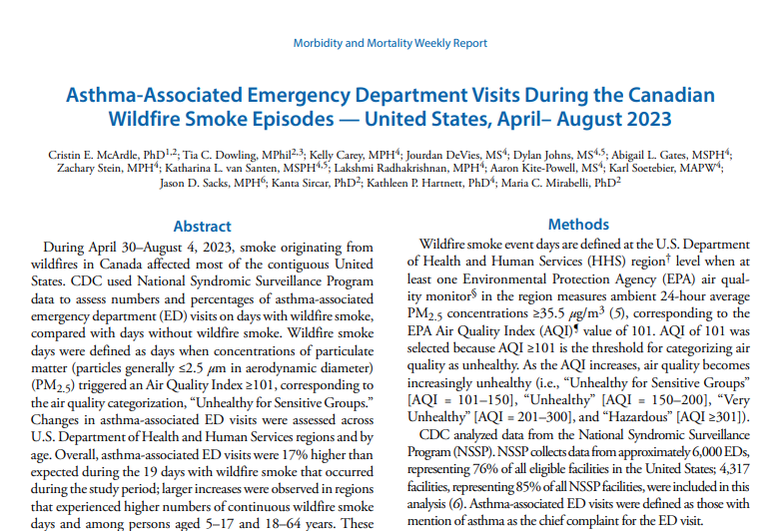
Sensitive Groups Health Effects
Wildfire smoke exposure of individuals with Asthma and Respiratory Disease:
  Breathing difficulties (e.g., coughing, wheezing, and chest tightness);
  Exacerbations of chronic lung diseases (e.g., asthma and COPD);
    Leading to increased medication usage, emergency department visits, and hospital admissions.
  Increased risk for asthma attacks for children with asthma.
Notes:
The CDC and EPA performed an assessment of asthma Emergency Department visits in the US during the Canada wildfires in 2023 and found that ED visits for asthma were 17% higher than expected during 19 days of wildfire smoke.
https://www.cdc.gov/mmwr/volumes/72/wr/mm7234a5.htm
Another study in Hoopa, in 1999, found that medical visits for respiratory illness increased by approximately 52% during weeks with an active forest fire over the previous year.
https://www.ncbi.nlm.nih.gov/pmc/articles/PMC1071703/

Slide 10
Sensitive Group Health Effects
Wildfire smoke exposure of individuals with Cardiovascular Disease:
  Triggering of ischemic events:
    Such as angina pectoris, heart attacks, and stroke.
  Worsening of heart failure; or abnormal heart rhythms:
    Leading to emergency department visits, hospital admissions, and even death.
Wildfire smoke exposure of Pregnant Women:
  Higher risk of preterm birth and lower birth weight in unborn baby.
    Similar effects to smoking commercial tobacco during pregnancy.

Slide 11
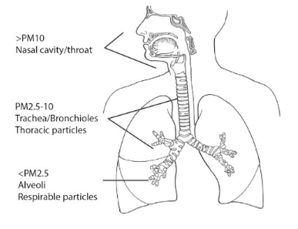
PM2.5 Exposure Pathology
Particles 2.5 micrometers or smaller can travel deep into lungs and possibly enter bloodstream. This can lead to:
  Oxidative Stress
    PM2.5 increases Reactive Oxygen Species (ROS), which leads to reduced antioxidants.
      Excessive ROS leads to cell damage, apoptosis, and carcinogenesis.
  Inflammation
    PM2.5 that enters blood can cause systemic inflammation and increased immune response.
      Interleukin-6 production causes a cascade effect of other inflammatory factors leading to cell damage.
  Cell Apoptosis
    PM2.5 causes mitochondrial dysfunction and up-regulates production of apoptosis related proteins.
Notes:
https://www.ncbi.nlm.nih.gov/pmc/articles/PMC4740125/
Image source: Impacts of Particulate Matter | Dust Mitigation Handbook (swclimatehub.info)
Particles 2.5 micrometers or smaller can travel deep into lungs and possibly enter bloodstream.
https://www.sciencedirect.com/science/article/pii/S0147651318313149
https://www.sciencedirect.com/science/article/pii/S004565352032631X
“the human body is efficient at filtering out the larger particles (> 10 μm) in the nasal passages, smaller particles on the scale of 5 μm get filtered out in the trachea. Fine particles can progress past the natural defenses into the bronchioles (< 2 μm) and some alveoli (< 1 μm) of the lungs. Once particles enter the lungs, the immune system sends white blood cells, called lymphocytes, to surround the particulates, protecting the body from the foreign objects. The lymphocytes settle on the alveoli walls, causing inflammation and scarring. The built-up scar tissue slows oxygen flow, making transfer of air to capillaries more difficult. This can be of particular concern to sensitive populations such as the elderly and asthmatics.”

Slide 12
Synergistic effects with Heat
Novoselov, 2022
  42% of Californians were exposed to combo of extreme heat and PM 2.5 in 2020, with rural residents most affected.
  Exposures to smoke and excess heat are expected to only get worse due to climate change.
  More research needs to be done to more accurately define the risk and mechanisms involved.
Rahman et al. 2022
  Study from 2014 to 2019, found that excess heat and PM 2.5 exposure had synergistic effect on mortality (death) risk.
  Exposure to both heat and particulate air pollution increased mortality risk by more than the sum of the increased mortality risk associated with each individual exposure to heat or smoke (5-6%).
    Mortality risk increased by over 21% on days with exposure to both heat and particulate air pollution.
  Effect largely seen in patients over 75 years old.
Notes:
The Effects of Coexposure to Extremes of Heat and Particulate Air Pollution on Mortality in California: Implications for Climate Change - PMC (nih.gov)
Dangerous combination of extreme heat and smoke affected 16.5 million Californians | UCLA

Slide 13
Recommended Interventions

Slide 14

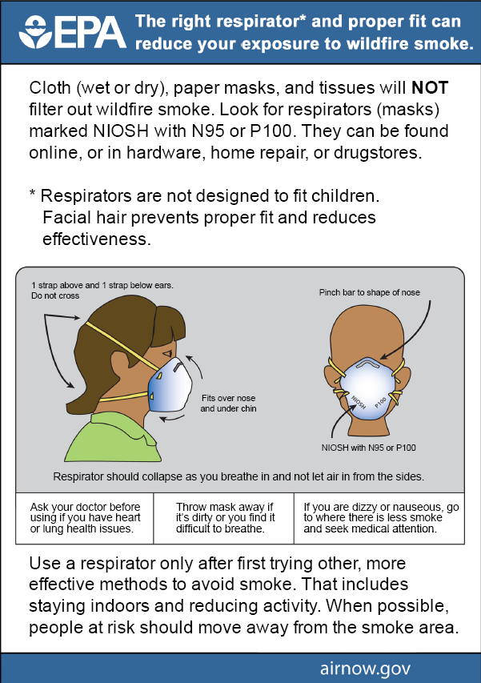
Recommended Interventions
Establish a Wildfire Action Plan with High-Risk Patients.
Establish a Communication Plan.
  Plan should address:
    Who should be given specific information.
    What information will be provided.
    When information will be delivered.
    What communication channels will be used.
HEPA Air Purifier Distribution Programs:
  Prioritize High Risk Groups
N95 Distribution:
  Should include training or distribution of handouts on proper donning.
Notes:
https://emergency.cdc.gov/han/2023/han00495.asp; https://www.airnow.gov/sites/default/files/2021-09/wildfire-smoke-guide-chapters-4-5.pdf
Wildfire Action Plan –
Plan that ensures patients understand risks present
Assesses their ability to access AQI information and understand it
Home assessment for indoor air pollution sources – help create a plan for their specific environment to reduce exposure
Create a tailored plan of action for each AQI category for their specific condition
Create a tailored plan for evacuation
Who should be given specific information – examples (schools, nursing homes, high risk patients), OES Staff/ Tribal EPA will likely be communicating smoke information to public, providers should be targeted messaging
When information will be delivered – (when AQI goes above 50 or 100, daily, weekly updates)
What communication channels will be used (social media, radio, door-to-door)

Slide 15
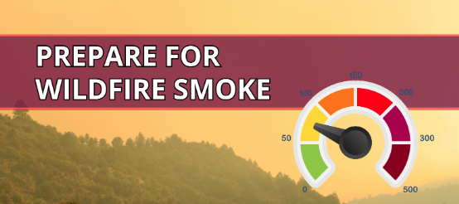
Recommended Interventions
During High Smoke Events (AQI above 100 for more than a few days):
  Monitor healthcare capacity and plan for facility surge due to asthma, COPD, and metabolic and cardiovascular disease exacerbations.
  Proactively counsel patients on strategies to avoid or reduce smoke exposure, especially among individuals with asthma, COPD, or cardiovascular disease, children, older adults, and those who are pregnant.
  Counsel High Risk patients to monitor their symptoms and have adequate stores of medications.
    Advise to have at least a 1 week supply on hand.
Notes:
https://emergency.cdc.gov/han/2023/han00495.asp
Strategies Include:
Staying indoors and preventing smoke infiltration
Avoiding smoking commercial cigarettes indoors, burning sage or incense
Monitoring local AQI information
Using a portable HEPA air cleaner
Selecting and using an N95 respirator
Locations of local clean air shelters

Slide 16
Provider Resources

Slide 17
Provider Resources
Wildfire Smoke: A Guide for Public Health Officials
  Has 5 Chapters that cover Wildfire Smoke Health Effects, Composition and Air Quality Impacts, Strategies to Reduce Exposure, Communication Strategies during Smoke Events, and Recommendations for Public Health Officials.
EPA Online Training for Health Professionals
  Wildfire Smoke and Your Patients' Health Online Training
  Particle Pollution and Your Patients' Health Online Training
  Other Health Care Professional Resources
Wildfires and Health for Providers Factsheet
  is a factsheet to help explain wildfire smoke health effects to patients
Establishing a Wildfire Action Plan for Providers
  a guide that can be used to help create a wildfire action plan for patients.
Reach out to your local IHS Environmental Health Officer for copies of handouts or other resources mentioned in this presentation.
Notes:
Wildfire Smoke: A Guide for Public Health Officials
Has 5 Chapters that cover Wildfire Smoke Health Effects, Composition and Air Quality Impacts, Strategies to Reduce Exposure, Communication Strategies during Smoke Events, and Recommendations for Public Health Officials.
Wildfires and Health for Providers is a factsheet to help explain wildfire smoke health effects to patients
Establishing a Wildfire Action Plan for Providers is a guide that can be used to help create a wildfire action plan for patients.

Slide 18
CA Area DEHS Contacts
OFFICE | NAME | TITLE | EMAIL | PHONE
IHS California Area Office | Carolyn Garcia | DEHS Director | Carolyn.garcia2@ihs.gov | 916-930-3981 x21336
Redding District Office | LT Rinnah Wyatt | Redding District EHO | Rinnah.wyatt@ihs.gov | 530-246-5339
Arcata Field Office | Aaron Alexander | Arcata Field EHO | Aaron.alexander@ihs.gov | 707-239-2559
Sacramento District Office | CDR Tim Shelhamer | Sacramento District EHO | Tim.Shelhamer@ihs.gov | 916-930-3981 x21338
Clovis Field Office | Alyssa Bernido | Clovis Field EHO | Alyssa.Bernido@ihs.gov | 559-322-7488 x27306
Escondido District Office | Brian Lewelling | Escondido District EHO | Brian.Lewelling@ihs.gov | 760-735-6891

